Slide 1
Benchmarking Temporal Grounding in Long-Form Video via Timestamp-Anchored Multiple-Choice QA Pairs
04.07.2026
Oluwatumininu Oguntola Advised by Professor Gedas Bertasius Honors Thesis Defense

Slide 2
The Agenda
Motivation
Existing Works
Methods
Evaluation
Results
Conclusions

Slide 3

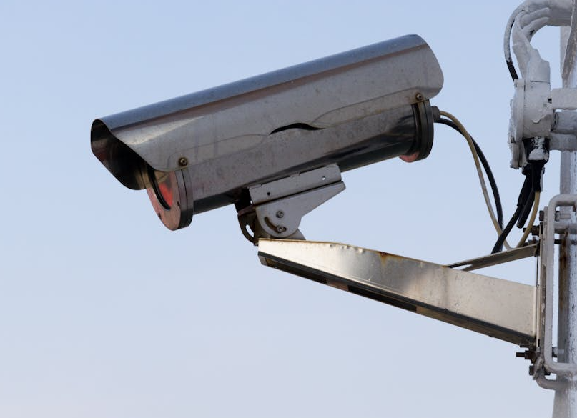
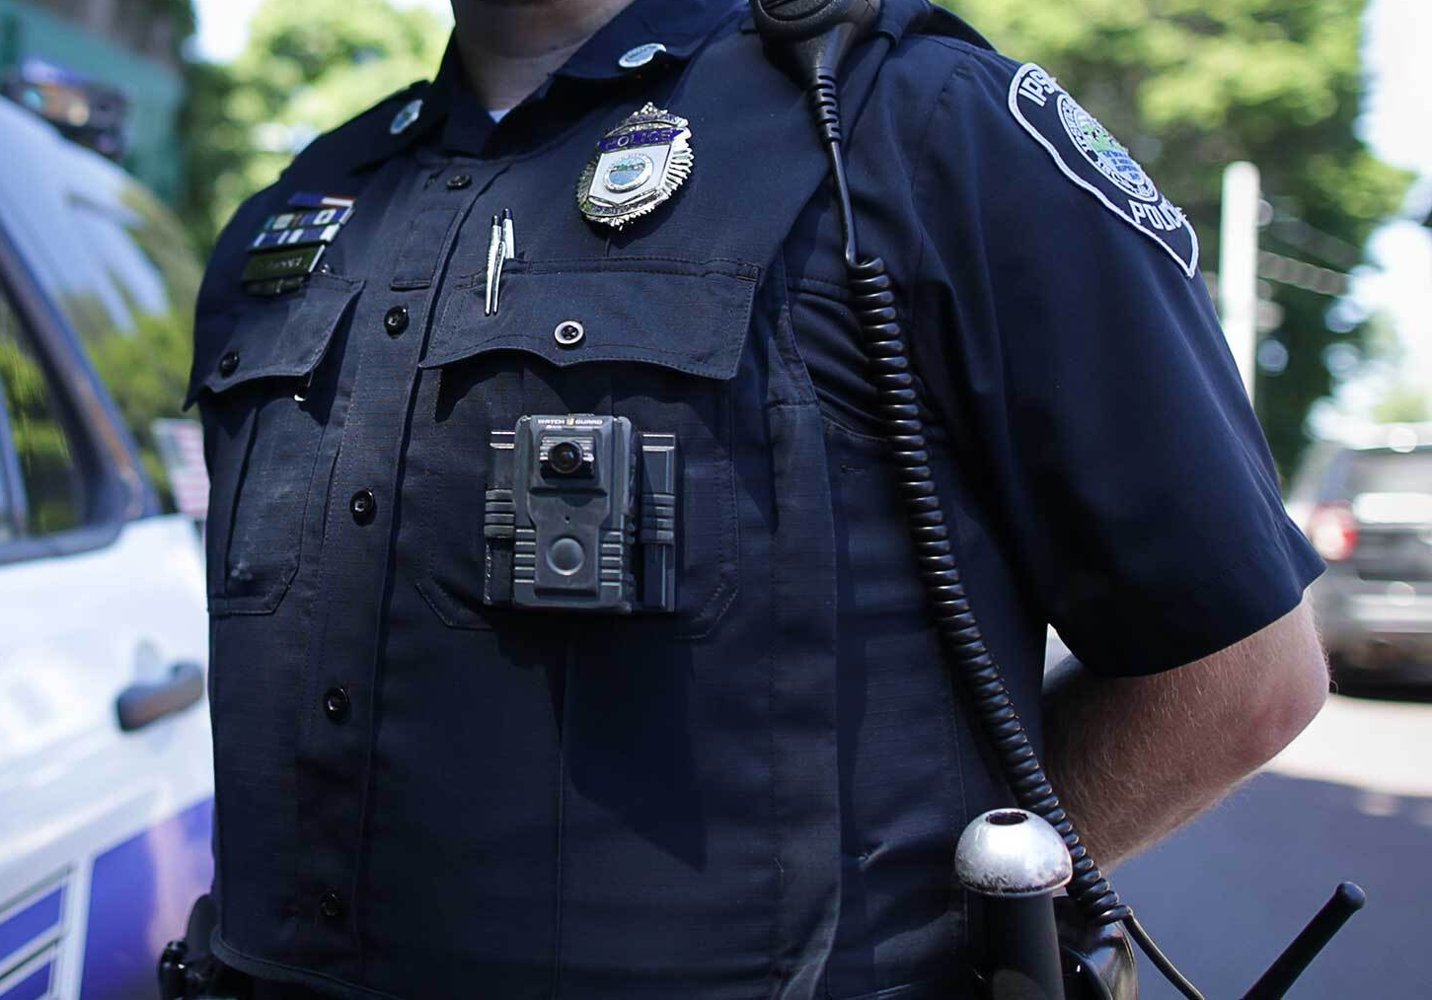
Motivation
Notes:
Everyday humans create and record millions of hours of video, to various social media platforms like YouTube, TikTok, Instagram. But we also record far more than that outside of social media. The US alone has tens of millions of static security cameras, a single police body cam can produce terabytes of data in a month, and as police bodycams become standard, more and more of this footage is recorded. All of this data has practical applications. Recordings made in surgery rooms can be used for review to improve technique & methods, Security footage can be reviewed for auditing & compliance, but can also be used for evidence in a court case. The main idea is, we record a whole lot more than we can realistically watch. This is an excellent application for VLMs.

Slide 4
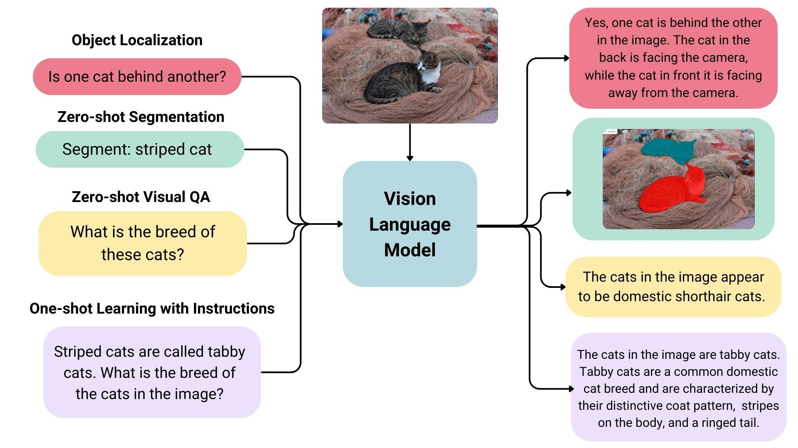
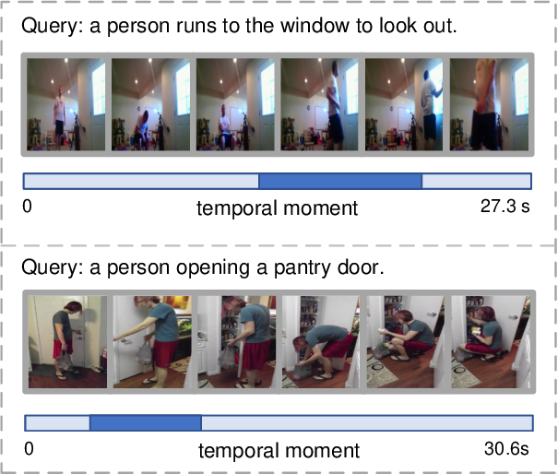
Motivation
Notes:
However, current VLMs are pretty good at identifying what happens in a video, or if certain things show up in the video, but struggle to identify when these things happen. Recordings made in surgery rooms can be used for review to improve technique & methods, Security footage can be reviewed for auditing & compliance, but can also be used for evidence in a court case.
Temporal grounding addresses this challenge by anchoring semantic understanding to a rigorous timeline, which is crucial for effectively addressing complex video understanding tasks. This anchoring enables precise retrieval of specific moments by natural
language query, causal linking of events separated by minutes, and structured summarization where every claim traces back to a verifiable segment.
Without robust temporal grounding, the outputs of video-language models remain ungrounded, lacking the evidence required for applications where temporal accuracy is non-negotiable. By enforcing a strict mapping between semantic content and the temporal axis, we enable a deeper, more structured evidence-based form of video reasoning necessary for deploying VLMs. However, without a benchmark that jointly evaluates answer correctness and temporal localization, there is no way to know whether any of these capabilities have been achieved.

Slide 5
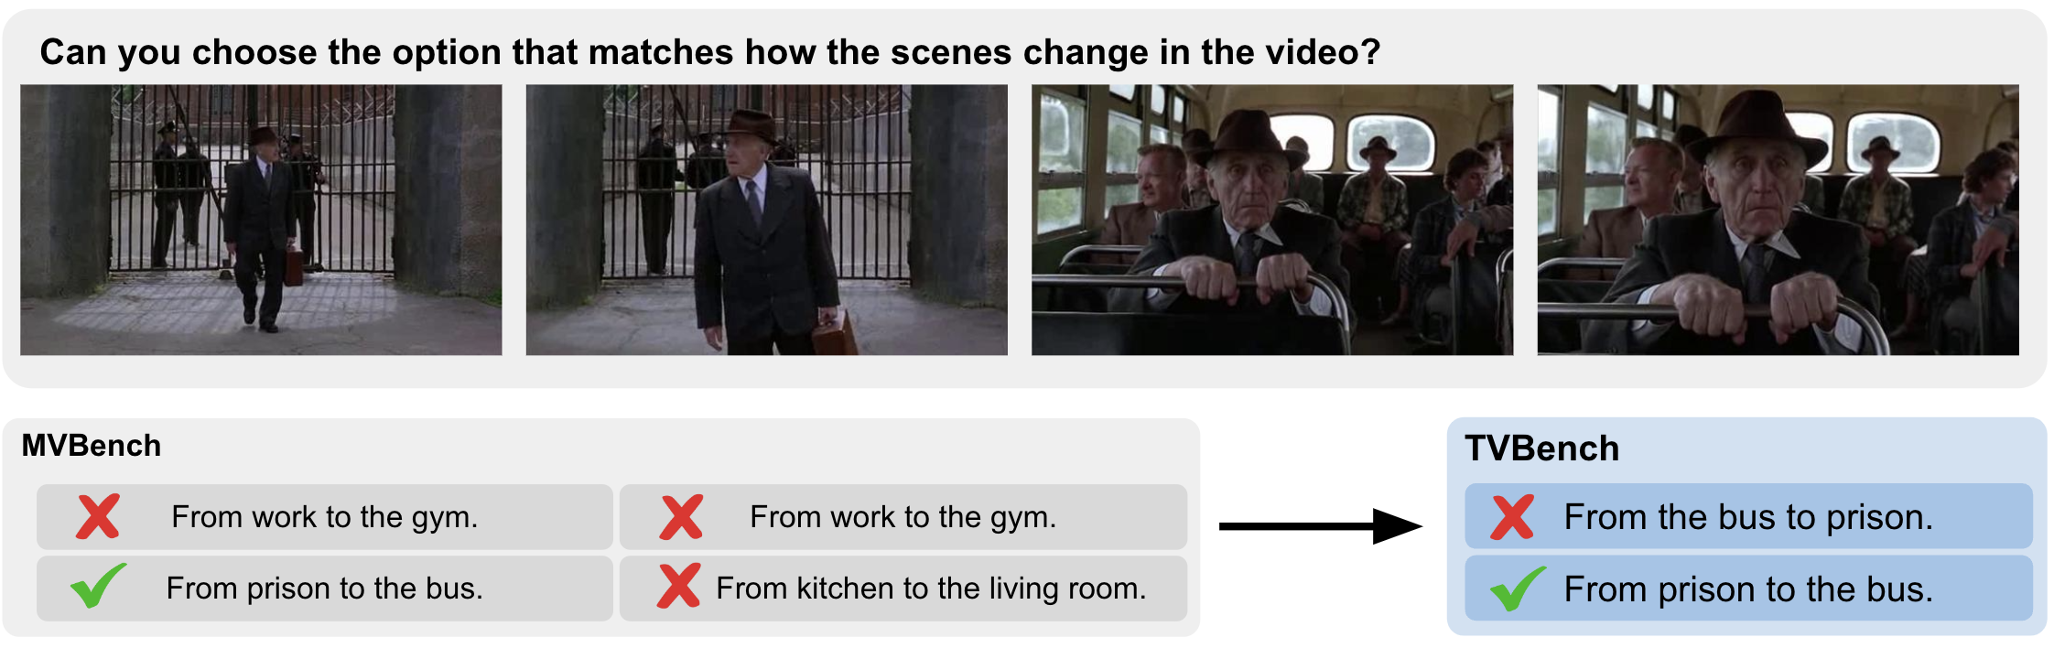
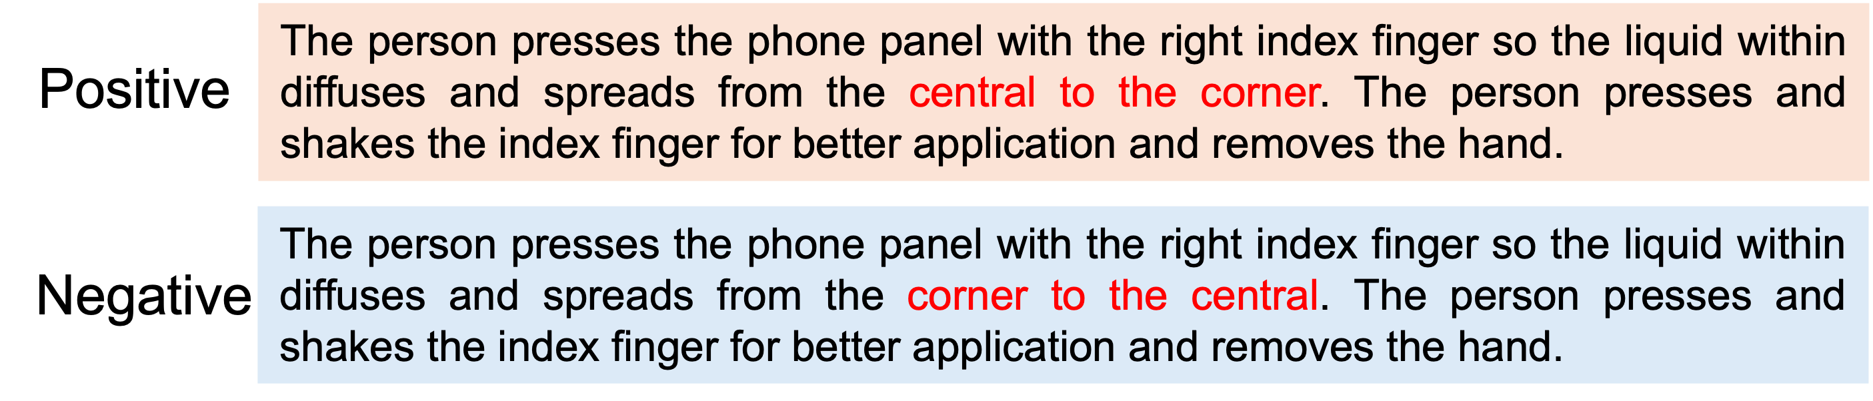
What about Existing Benchmarks?
Notes:
Current video benchmarks provide questions and answers but lack explicit temporal grounding. At the top is TVBench, an expansion of MVBench, that uses clips 5-35s long and assesses, among many other things, temporal understanding of MLLMs.
This benchmark, among many others, does not direct models to the specific moments where answers can be found nor assesses their ability to produce segments or timestamps for those moments.
This leaves models unable to reliably locate key events or reason precisely about when things occur in a video.
Some works propose temporal understanding, but they remain clip-level discrimination tasks that neither require models to localize events in time nor reason about their precise temporal position within a video, leaving temporal localization
entirely unaddressed. Below is such a benchmark, TemporalBench, that provides the model with a clip-level discrimination task, to determine whether the positive or the negative description is accurate to a given clip.
Without assessing the model’s ability to understand temporal structure, models are left to rely on static visual cues or linguistic shortcuts.

Slide 6
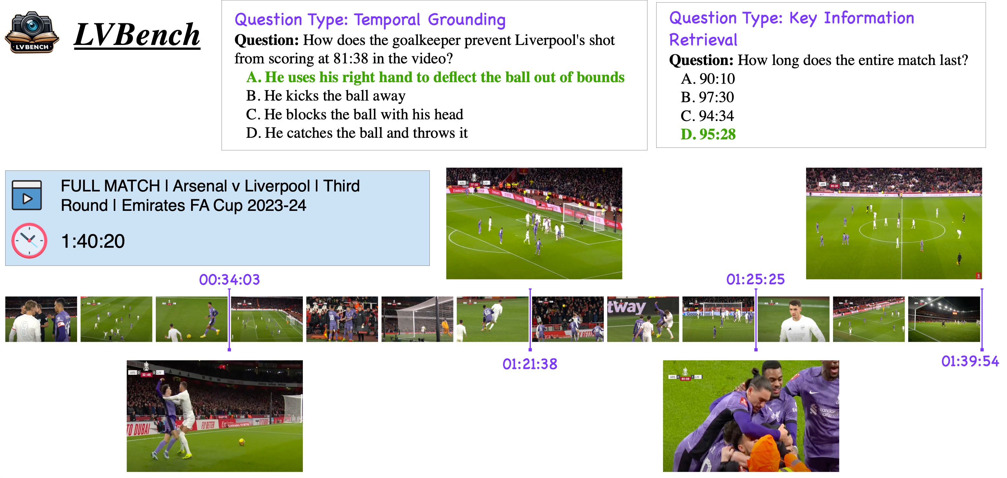
What about Existing Benchmarks?
Notes:
Clip-level: Video-MME, SEED-Bench, EgoSchema, TemporalBench - Segment-level: MVBench, LongVideoBench - Timestamp-level (short video): Charades-STA, ActivityNet-QA
Various video benchmarks like Video-MME, MVBench, EgoSchema, TemporalBench, and SEED-Bench, assess model temporal understanding, but do not do so with any sort of timestamp information based on the video.
Benchmarks like Charades-STA, ActivityNet-QA are confined to short videos, no more than 3 minutes long. They also use regression-based evaluation, making them incompatible with the standardized multiple-choice question (MCQ) evaluation currently dominating VLM assessment.
LongVideoBench, the benchmark currently displayed on screen, provides models with the relevant timestamp when assessing temporal grounding, still asking the model to answer the given question, except it is given the timestamp as a clue to locate the relevant segment.
The real issue is that existing VideoQA benchmarks evaluate answer correctness in isolation, without verifying temporal evidence. The problem is not that models answer incorrectly, but that we have no way to verify whether a correct answer reflects temporal understanding or a lucky guess. No benchmark jointly measures answer accuracy and timestamp localization in long-form video. A model may select correct answers for systematically wrong reasons, getting lucky and getting the question correct.

Slide 7
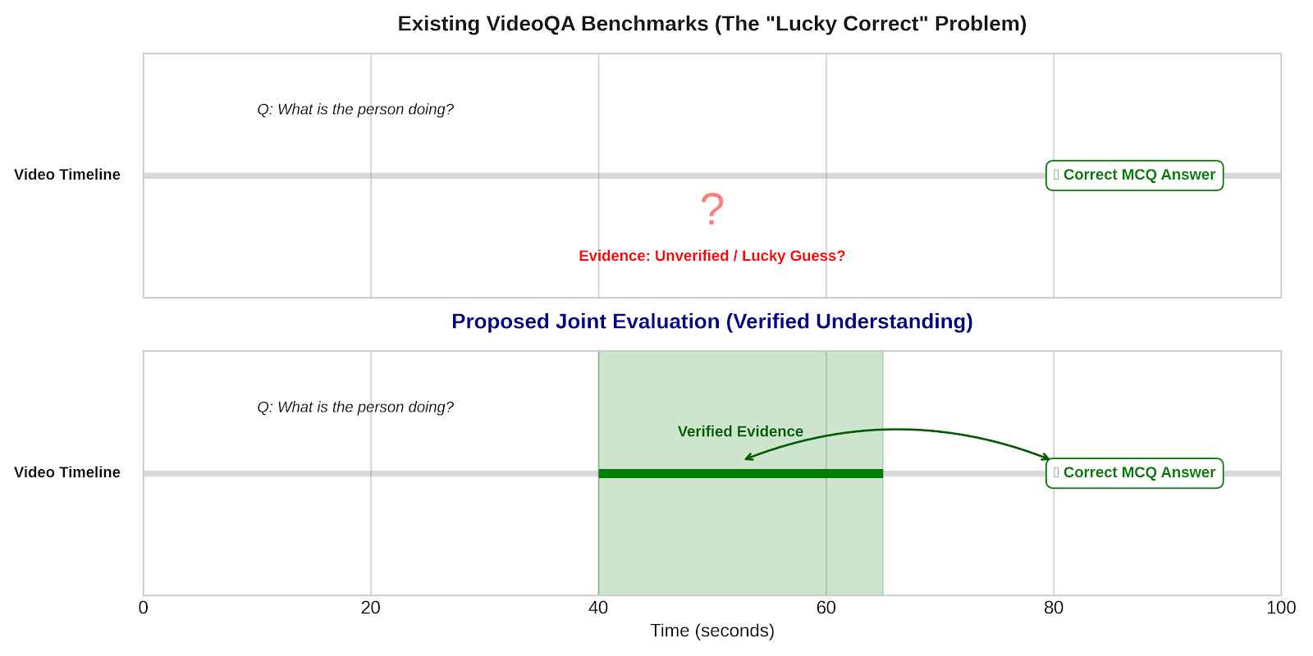
What about Existing Benchmarks?
Notes:
Thus, the solution is conceptually simple: every correct answer should carry a verifiable timestamp, so that answer accuracy and temporal localization can be jointly evaluated.

Slide 8
ChronoQA
A BENCHMARK TO ASSESS VLM TEMPORAL GROUNDING
423 long-form YouTube videos (10–90 minute)
Median: 25 min
Mean: 35 min
897 timestamp-anchored, five-option MCQ pairs
Text-only solvability constrained to 17.8%, near the 20% random baseline

Slide 9
Constructing ChronoQA

Slide 10
Video Sourcing
Initial YouTube video scraping using varied search-terms for content category diversity
Results in 90,000+ candidate videos
Filter by duration (10-90 minutes), content type (varied), and licensing
Separated into two tiers
Top 30,000 (Longest Videos by Duration)
Remaining 60,000

Slide 11
Video Sourcing
Need sufficient temporal dynamics for meaningful reasoning
Apply visual diversity filter with a delta score derived from CLIP embeddings (quantifies visual variance)
Use score to exclude visually static/stagnant videos from each collection
Left with 26,959 videos in the first collection and 13,544 videos in the second
Notes:
Reasoning cannot be properly assessed on static content. so we need to ensure that the video is dynamic enough for reasoning to matter/be significant, and assess the model’s ability to understand change over time and what not.

Slide 12
Video Sourcing
Random sample of 250 videos from each collection

Slide 13
Caption Generation
Existing VLMs excel on captioning & descriptive tasks
Segment each video into fixed-length clips of 10s
10s clips capture fine-grained event details without over-generalizing across broader scene transitions
Process each segment at 1 frame per second (FPS) with captioning instructions using Qwen3-VL-30B, record generated caption with timestamp and source video

Slide 14
Caption Generation

Slide 15
QA Generation
We feed the following into Qwen3-Next-80B-Thinking:
Clip captions for each clip
The timestamp associated with each caption
1 of 5 Specialized Prompt templates for each of our tasks:
Action Understanding
Needle-in-the-Haystack
Narrative Understanding
Causal Understanding
Ordering
Each template generates 3 question answer pairs, grounded in the video content using the caption timestamps
Notes:
All templates constrain questions to avoid direct temporal references (no "when," "beginning," or timestamp references), and only the correct answer carries a temporal annotation in the form of start and end timestamps for the relevant segment.
We constrain the model to a pydantic schema, a python library used for data validation, via our inference engine’s structured outputs, to guarantee each response contains well-formed question-answer pairs with their associated timestamps.
Though failures can occasionally arise in the generation process due to rare model hallucinations, token budget consumption, or malformed/incomplete JSON response, this process succeeds 98% of the time.

Slide 16
QA Generation
Notes:
All templates constrain questions to avoid direct temporal references (no "when," "beginning," or timestamp references), and only the correct answer carries a temporal annotation in the form of start and end timestamps for the relevant segment.
We constrain the model to a pydantic schema, a python library used for data validation, via our inference engine’s structured outputs, to guarantee each response contains well-formed question-answer pairs with their associated timestamps.
Though failures can occasionally arise in the generation process due to rare model hallucinations, token budget consumption, or malformed/incomplete JSON response, this process succeeds 98% of the time.

Slide 17
Validation & Cleaning
A pattern-matching filter is applied to remove temporally self-referential questions
"When was X shown?”
"In which segment did Y occur?”
These questions are structurally incompatible with our evaluation design
Although the generation prompt is explicitly conditioned against producing such questions
This filter serves as a deterministic safeguard to ensure none reach the final dataset
Adjacent Timestamp Merging
Notes:
Because the benchmark measures a model’s ability to produce a content answer and a grounding interval separately, questions that collapse these two into a single temporal response cannot be scored in any principled way
Although the generation prompt is explicitly conditioned against producing such questions, this filter serves as a deterministic safeguard to ensure none reach the final dataset.
Next, we apply timestamp merging to consolidate multiple timestamp entries, merging adjacent segments separated by less than 2 seconds into a single continuous range to avoid fragmentation.
Finally, a timestamp jitter is applied to increase ground-truth variability. Since our captions are generated from fixed 10-second clips, LLM-generated timestamps are ordinarily constrained to 10-second boundaries.
To produce more varied annotations, we shift the recorded start timestamp earlier by a random variable X sampled uniformly from 1 to 3 seconds
timestamp later by 𝑋 ∼ Unif ({1, 2, 3}) seconds, stopping at the
existing video’s boundaries (Can’t be less than 0, or longer than the
video). This also provide tolerance for imprecise annotations when
ground-truth ranges are smaller than the clip length.

Slide 18
Validation & Cleaning
Notes:
Because the benchmark measures a model’s ability to produce a content answer and a grounding interval separately, questions that collapse these two into a single temporal response cannot be scored in any principled way
Although the generation prompt is explicitly conditioned against producing such questions, this filter serves as a deterministic safeguard to ensure none reach the final dataset.
Next, we apply timestamp merging to consolidate multiple timestamp entries, merging adjacent segments separated by less than 2 seconds into a single continuous range to avoid fragmentation.
Finally, a timestamp jitter is applied to increase ground-truth variability. Since our captions are generated from fixed 10-second clips, LLM-generated timestamps are ordinarily constrained to 10-second boundaries.
To produce more varied annotations, we shift the recorded start timestamp earlier by a random variable X sampled uniformly from 1 to 3 seconds
timestamp later by 𝑋 ∼ Unif ({1, 2, 3}) seconds, stopping at the
existing video’s boundaries (Can’t be less than 0, or longer than the
video). This also provide tolerance for imprecise annotations when
ground-truth ranges are smaller than the clip length.

Slide 19
Timestamp Jitter
Since clips are 10s, ground truth timestamps are constrained to 10-second boundaries
Shift recorded starting and ending timestamp
Also provides tolerance for imprecise annotations
Notes:
Finally, a timestamp jitter is applied to increase ground-truth variability. Since our captions are generated from fixed 10-second clips, LLM-generated timestamps are ordinarily constrained to 10-second boundaries.
To produce more varied annotations, we shift the recorded starting timestamp earlier by a random variable X, and shift the recorded ending timestamp by Y, where X and Y are sampled uniformly from 1 to 3 seconds. We also apply clamping to ensure the starting timestamp does not go negative if the timestamp is at the beginning of the video, and that the timestamp does not exceed the duration of the video.
This also provides tolerance for imprecise or noisy annotations when ground-truth ranges are smaller than the clip length.

Slide 20
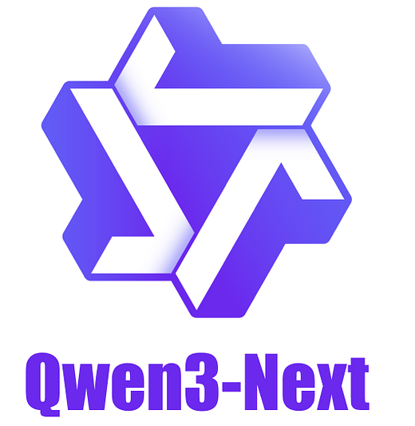
Distractor Synthesis
Using Qwen3-Next-80B-Thinking, we generate four plausible distractors using:
The existing question
The correct answer
Captions in a 30s margin near the ground truth timestamp
Options must be:
Plausible within question context
Belong to the correct answer’s semantic category
Match the correct answer’s length and casing
Unambiguously incorrect
Notes:
For each question, we conduct a separate pass using Qwen3-Next-80B-Thinking to generate four incorrect, but plausible distractors for the original question-answer pair. The model is instructed to produce options that are plausible within the question’s context, meaning that it must be a fair/sensible answer to this type of question.
It must belong to the answer’s semantic category, meaning that if the answer is a color then the distractors must also be colors. If the correct answer is a brand, then then distractors must also be brands, and so on and so forth.
It must match the correct answer’s length and casing, in order to avoid language bias. Previous works have shown Large Language Models excel at taking advantage of language biases when answering questions. We want to prevent this phenomenon whenever possible so we assess the model’s reasoning ability, rather than its ability to take advantage of language shortcuts. To that end, we want all distractors of similar length and casing as the correct answer. A model can easily mark an answer correct if it is in all caps but the remaining distractors are not. Additionally if the correct answer is notably longer or shorter than the other distractors, this can also be a shortcut that LLMs take to answer the question, even without video context.
Finally, the distractors must be unambiguously incorrect. Distractors should not be arguable as correct answers in any way, they should be incorrect with no question.
To do this we give the model the existing question and correct answer made in the previous LLM pass. We also include timestamp-anchored captions in temporal proximity to the question’s timestamp ground truth providing the model with localized context to ground distractors in actual video content. Questions for which fewer than four valid distractors can be generated (meaning distractor synthesis fails) are discarded. If synthesis succeeds, the correct answer and four distractors are randomly shuffled and the position of the correct answer is recorded as a letter.
Correct-answer positions are uniformly distributed (from A–E) to eliminate positional bias

Slide 21
Distractor Synthesis
Notes:
For each question, we conduct a separate pass using Qwen3-Next-80B-Thinking to generate four incorrect, but plausible distractors for the original question-answer pair. The model is instructed to produce options that are plausible within the question’s context, meaning that it must be a fair/sensible answer to this type of question.
It must belong to the answer’s semantic category, meaning that if the answer is a color then the distractors must also be colors. If the correct answer is a brand, then then distractors must also be brands, and so on and so forth.
It must match the correct answer’s length and casing, in order to avoid language bias. Previous works have shown Large Language Models excel at taking advantage of language biases when answering questions. We want to prevent this phenomenon whenever possible so we assess the model’s reasoning ability, rather than its ability to take advantage of language shortcuts. To that end, we want all distractors of similar length and casing as the correct answer. A model can easily mark an answer correct if it is in all caps but the remaining distractors are not. Additionally if the correct answer is notably longer or shorter than the other distractors, this can also be a shortcut that LLMs take to answer the question, even without video context.
Finally, the distractors must be unambiguously incorrect. Distractors should not be arguable as correct answers in any way, they should be incorrect with no question.
To do this we give the model the existing question and correct answer made in the previous LLM pass. We also include timestamp-anchored captions in temporal proximity to the question’s timestamp ground truth providing the model with localized context to ground distractors in actual video content. Questions for which fewer than four valid distractors can be generated (meaning distractor synthesis fails) are discarded. If synthesis succeeds, the correct answer and four distractors are randomly shuffled and the position of the correct answer is recorded as a letter.
Correct-answer positions are uniformly distributed (from A–E) to eliminate positional bias

Slide 22
Blind Filtering
Notes:
As I mentioned earlier, previous works language models can sometimes identify the correct answer to a multiple-choice question without visual input by exploiting shared linguistic patterns between the question and the ground truth (or correct answer). This occurs more so when the distractors are lightly edited variants of the correct answer. To remove questions susceptible to this bias, we apply a blind filtering procedure to each QA sample. Each QA sample, consisting only of the question text and five answer options, without any video context, is presented to five state-of-the-art LLMs. Each model is prompted to select the correct answer under the same task framing used in full evaluations. Any QA sample that is answered correctly by at least two of these models is considered solvable through language-only, and is discarded from the final dataset, ensuring that retained questions require visual grounding instead of linguistic pattern matching. This constrains the text-only solvability rate of the final set to at or below the random baseline for a five-way multiple-choice question at 20%.
Language models can sometimes
identify the correct answer without visual input by exploiting
shared linguistic patterns between the question and the ground
truth, particularly when distractors are lightly edited variants of
the correct answer [2]. To remove questions susceptible to this
bias, we apply a blind filtering procedure in which each QA sample,
consisting only of the question text and five answer options, with
no videos, is presented to five SOTA LLMs. Each model is prompted
to select the correct answer under the same task framing used in
full evaluation. Any sample for which at least two models selects
the correct answer is considered language-solvable, and is removed
from the dataset, ensuring that retained questions require visual
grounding rather than linguistic pattern-matching. The text-only
solvability rate of the retained set is constrained to at or below the
random baseline for a five-way multiple-choice question at 20%.

Slide 23
Task Taxonomy
Notes:
Our questions each fall into one of five complementary reasoning categories, ordered by scope and difficulty.
Action Understanding questions task the model with identifying fine-grained procedural details, usually with the scope of a single segment within the video. Needle-in-the-Haystack questions ask the model to retrieve specific visual/textual details, which could be anywhere within the full video.
Narrative Understanding questions test the model’s ability to synthesize overarching narratives within the video, and requires the model to synthesize information from all over the video to answer correctly
Causal Understanding questions assess the model’s ability to integrate non-adjacent evidence for causal inference, and requires the model reason across segments within the video.
Finally, Temporal Ordering requires the model to reason about the structure of sequential events within adjacent segments of the video.
NIAH timestamps uniformly distributed across video duration to counter start/end positional bias\
To prevent positional bias, when generating questions, we prompt the model to draw from different scenes or settings spread across the video, instead of clustering around a single location or moment.

Slide 24
ChronoQA
Notes:
After processing the 500 videos, generating ~X questions, then generating distractors for em, and then having ~Y left, the complete set uses 423 videos from the original 500, along with the total remaining 897 QA pairs.

Slide 25
Model Evaluation

Slide 26
Evaluation Protocol: Dual-Metric Design
QA Accuracy: Percentage of correctly selected answer options
Mean Temporal IoU (mIoU): Average intersection-over-union between predicted and ground-truth timestamp intervals
Grounded Accuracy (G-Acc): Joint metric. Correct answer selection and Temporal Intersection over Union (tIoU) ≥ 0.5
Recall@IoU: Averaged over thresholds {0.1, 0.2, 0.3, 0.4, 0.5};
Captures distribution of grounding quality across the full IoU spectrum
Notes:
This helps us Illustrate the grounding gap: a model that got the correct answer, but predicts a ground truth timestamp of [0:00–44:29] achieves a QA Accuracy of 1 for the question, but a grounded accuracy of 0 due to its extremely imprecise temporal intersection over union. (Figure 6)
To further improve the robustness of question grounding evaluation, we use the rec.@IoU metric, motivated by a previous work (CG-Bench). This metric measures the probability of successfully recalling clue intervals at various IoU thresholds. We calculate the average recall rate at IoU thresholds of 0.1, 0.2, 0.3, 0.4, and 0.5 to determine the final result.
In addition, we propose a combined metric, G-Acc that evaluates both MCQ accuracy and clue grounding ability. For a question with multiple choice options, the response is considered correct only if the selected answer is accurate and the tIoU between the prediction and the ground truth exceeds (>) a predefined threshold τ. Since locating short-duration clues in the long videos in is inherently challenging, we set the default τ to be 0.5, ensuring that G-Acc requires the model to select the correct option and produce a time interval that overlaps at least half (tIoU > 0.5) of the annotated clue interval, rather than reducing to naive MCQ accuracy.

Slide 27
Evaluation Protocol: Dual-Metric Design
Notes:
This helps us Illustrate the grounding gap: a model that got the correct answer, but predicts a ground truth timestamp of [0:00–44:29] achieves a QA Accuracy of 1 for the question, but a grounded accuracy of 0 due to its extremely imprecise temporal intersection over union. (Figure 6)

Slide 28
Evaluated Models
Model | Provider | Access | Context Length | Video Input
GPT-5.4 | OpenAI | API | 400K Tokens | Frame Sampling
Gemini 3.1 Flash | Google | API | Up to 1M Tokens | Native Video Input
Qwen3-VL-8B | Alibaba | Open-source | 256K Tokens | Existing Frame Sampling Impl.
Molmo2-8B | Allen Institute for AI | Open-source | 36K Tokens | Existing Frame Sampling Impl.
Notes:
Models are evaluated zero-shot, with a standardized 64-frame budget for models without built-in frame sampling. We choose this number in accordance with prior works for comparison.
We extract the answers and timestamps in two stages. First we prompt the model to answer the question and select one of our answers A-E using the provided video or sampled images. After the model chooses an answer, we ask it to ground the correct answer with a timestamp. To extract answers and timestamps, we use a two-stage extraction process. Model responses are constrained with pydantic schemas when possible. Responses are then parsed using regex rules. If this fails, we pass the response to OpenAI’s GPT-4o as an LLM-based fallback, which then takes the raw model response and constrains it to our schema for accuracy evaluation.

Slide 29
Results

Slide 30
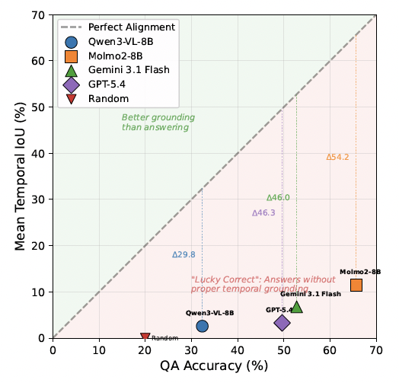
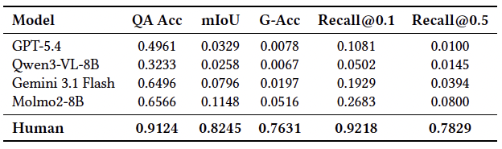
Main Findings
Notes:
Main finding is that no model exceeds a 5.16% Grounded Accuracy, despite having QA accuracies ranging from 32 to to 66%
This table and the graph on the left let us visualize the grounding gap. All models fall substantially below the perfect-alignment diagonal, where we would hope to have our models fall along, with a direct correlation between their QA accuracy and their Mean Temporal IoU, indicating that their ability to answer questions correctly goes hand-in-hand with their ability to ground and support them with video evidence.
Looking at the human baseline, we see that humans perform far better than all evaluated models on QA Accuracy, and grounding capabilities.
Though Molmo2 leads on both QA Acc (65.7%) amd mIoU (11.5%), humans still perform 25% better than Molmo2 on QA Acc, 71% better than Molmo2 on grounding, and 71% better on grounded accuracy. Humans similarly perform 66% and 70% better than Molmo2 on Recall @ 0.1 and 0.5, respectively. This also challenges the general assumption that parameter scale is the primary performance driver, especially in comparison to Gemini 3.1, a larger model with native video support.

Slide 31
The Grounding Gap
Greatest Gap is with GPT-5.4: 49.6% QA Acc vs. 3.3% mIoU
Molmo2 and GPT-5.4 exceed 80% QA Acc on Narrative Understanding questions, but both remain below 11% mIoU
These scores indicate that models may be exploiting linguistic plausibility, common-sense elimination, and narrative coherence rather than temporal evidence to answer questions
Gap in performance is difficult to attribute to dataset artifacts due to ChronoQA’s blind filtering controls
Temporal Ordering: All models fall below 34% QA Acc and 2.4% mIoU, suggesting that understanding the sequential structure of events within a video remains an open problem for all evaluated model architectures

Slide 32
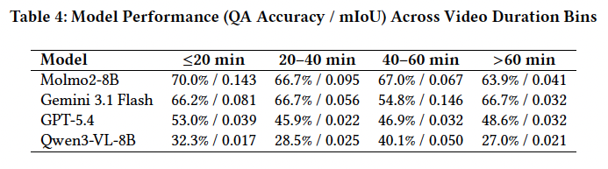
Performance by Duration
Notes:
To examine how video length affects model performance, we arrange results across four duration bins: short (≤20 minutes), medium (20–40 minutes), long (40–60 minutes), and extended (>60 minutes).
Duration analysis of QA accuracy & mIoU by category shows a monotonic performance decline as video length increases across all models. This reinforces the hypothesis that extended temporal contexts impose
significant demands on models’ long-range reasoning and evidence retrieval.
Molmo2-8B demonstrates the most robust grounding performance, maintaining a superior mIoU compared to its peers across all categories, though it experiences a monotonic decline from 14.3% in the short bin to 4.1% in the extended bin.
On the other hand, GPT-5.4 and Qwen3-VL-8B struggle to maintain grounding precision, with mIoU often remaining below 4% and 5% respectively in the longer bins, suggesting that fixed-rate frame-sampling strategies may become inadequate as temporal density increases.
Gemini 3.1 Flash shows a unique performance profile across the four duration bins. While its QA accuracy remains resilient, recovering to 66.7% in the extended bin, its grounding capability is highly volatile, peaking at 14.6% mIoU in the long bin (4-60 minutes) before regressing to 3.2% for videos in the extended bin (longer than 60 mins)
I believe these findings underscore the importance of temporal scalability, specifically the ability to maintain precise grounding capabilities in high-density contexts, still remains a critical bottleneck for the development of next-generation video-language models

Slide 33
Error Taxonomy
Temporal Displacement: Correct event identified, attributed to incorrect segment
Prevalent in NIAH and Ordering Tasks
Correlated with Sparse Frame Sampling
Plausibility Substitution: Semantically coherent, contextually reasonable answer selected without video grounding
Dominant in Causal Reasoning tasks
Suggests reliance on world-knowledge priors over temporal observation
Boundary Imprecision: Correct temporal region identified but interval predictions are too broad
Manifests as a steep Recall drop-off between @0.1 and @0.5 thresholds
Molmo2 least affected, suggesting tighter interval estimation from training
Notes:
The first and most prevalent failure mode is temporal displacement, where a model identifies the correct event or action but attributes it to the wrong temporal segment.
This error is particularly common in NIAH and Temporal Order tasks, where multiple superficially similar events occur across a video and the model lacks the resolution to discriminate among them.
GPT-5.4 and Qwen3-VL-8B exhibit this pattern most frequently, which is consistent with their reliance on sparse frame sampling.
The second failure mode is plausibility substitution, where a model selects an answer that is semantically coherent and contextually reasonable but isn’t grounded in the actual video content.
This error is most evident in Causal Reasoning tasks, where questions of the form “why did X happen” admit plausible answers that don’t require temporal evidence.
The near-zero grounding scores in this category across all models strongly suggests that correct QA answers are inferred rather than reasoned upon. Models may draw on general world knowledge or narrative plausibility rather than attending to specific video content. In our evaluations, and even during blind filtering and baseline evaluations to ensure performance without video-context was at or around 20%, no models refused to answer our questions.
Confirming this mechanism directly would require analysis of model reasoning traces, but the grounding evidence alone suggests that causal questions are particularly susceptible to this form of error.
This occurs because models rarely refuse to answer questions, even if they cannot logically answer the question based on given context, and will instead guess.
The third pattern is boundary imprecision, in which a model correctly identifies the relevant temporal region but produces grounding intervals that are too broad or misaligned relative to the ground truth annotation. This manifests as low Recall@𝜏 at stricter IoU thresholds even when coarse localization succeeds, and is visible across all models in the rapid drop-off between Recall@0.1 and Recall@0.5.
Molmo2 is least affected by this pattern, suggesting that its training encourages tighter interval estimation.
Together, these failure modes indicate that improving temporal grounding will require not only richer video representations but also training objectives that explicitly reward precise evidence localization rather than just answer correctness.

Slide 34
Implications & Future Work
Training Objectives: Temporal grounding must be treated as a first-class criterion, not a secondary annotation models require explicit reward signals for precise interval prediction
Architectural design: Frame-sampled models are structurally ill-suited for dense temporal tasks, continuous or high-density video representations warrant investigation
Benchmark extensions: Multi-annotator human baseline collection & expansion of evaluated models as the VLM landscape evolves
Causal grounding: Connecting causal inference to verifiable temporal evidence remains an open research problem
Notes:
Temporal grounding must be treated as a first-class criterion, not a secondary annotation. To see improved performance from our models will require explicit reward signals for precise interval prediction
Frame-sampled models are structurally ill-suited for dense temporal tasks like temporal grounding, and continuous or high-density video representations greatly warrant further investigation for this task. Molmo2 for example compresses the patches from encoding video frames with its vision transformer into pooling windows to keep long clips tractable, and then interleaves these tokens with text and timing information before entering the LLM, where these tokens can attend to one another across frames and images, which significantly boosts their multi-image and video performance, along with various other efficiency techniques. They also assemble several new datasets covering various tasks to support spatio-temporal grounding.
The current human baseline was collected from a single annotator, which makes calculation of inter-annotator agreement impossible and may reflect individual variation in timestamp granularity. Thus, we present these figures as an indicative upper bound instead of a definitive measure of human capability on ChronoQA, and identify the collection of a multi-annotator human baseline as a priority for future work.
Finally, the consistent failure across models on Causal Reasoning grounding indicates that we currently lack the adequate mechanisms for connecting causal inference to observable temporal evidence, and we hope to see future research on this field.

Slide 35
Concluding Remarks

Slide 36
Conclusion
ChronoQA establishes a principled, dual-metric framework for evaluating temporal reasoning and grounding in long-form video
The persistent grounding gap across all evaluated architectures, including frontier proprietary models, demonstrates that high answer accuracy cannot be taken as evidence of temporal understanding
The open-source Molmo2 outperforms larger proprietary systems on both metrics, underscoring the primacy of video-native architectural design over parameter scale

Slide 37
Acknowledgements
Gratitude to Dr. Gedas Bertasius for Mentorship over the last 3 years
Extremely Thankful for Emon Islam, Yulu Pan, Ce Zhang, and the Multimodal Video Perception group here in the Computer Science Department at UNC Chapel Hill
Everyone that’s pushed me to keep going, even when things were hard

Slide 38
Open to Questions

Slide 39
End Slide 2 – Carolina Blue

Slide 40
MCQ Benchmarks
Multiple-choice questions (MCQs) are popular for LLM assessment primarily due to their simplicity, efficiency in large-scale evaluation, and ease of automated scoring.
They allow for quick, objective testing across broad topics, enabling benchmarks to assess knowledge-intensive capabilities at a low cost.
Key Reasons for Using MCQs in LLM Evaluations:
Scalability & Cost: MCQ evaluation is efficient and often cheaper than generative evaluation, allowing vast, automated testing of models.
Simple Scoring: Unlike open-ended responses that require complex evaluation, MCQ results provide clear-cut accuracy metrics based on finding the right answer.
Benchmark Standardization: Many prominent, established evaluation datasets are formatted as MCQs.
University, Division or Unit Name Goes Here (or delete)

